Slide 1
Embedded Systems’ Project
Temperature Monitor and Cooling System
Presented by : Mustfa Alhasanat
Supervised by : Dr. Aymen Mansor

Slide 2
1
Contents
Introduction
Communication and Control Systems
Block Diagram & Flow chart
Circuitry, Coding and App
Electrical Components
Presenting the Project
Challenges & Solutions

Slide 3
Introduction
2
Collecting data: The sensor constantly read the temperature of the room
Periodically sending data: We send all collected data from the sensor to the online server
Checking for the problem: Compare the received reading with the threshold
Auto response: Control the fan based on the reading of the sensor
Its importance: We can monitor the temperature in our house or around any circuit panel via internet with knowing that the fan will cool the area if it got heated

Slide 4
3
Electrical Components
Arduino UNO
ESP8266
Relay module
Breadboard
Heat sink
DHT11 sensor
potentiometer
MOSFET (IRF540N)
resistor
Jumper wires
9V Battery
DC motor
Toy fan
Toy house
USB cable
Total cost: around 30JD

Slide 5
Communication and Control Systems
4
UART system: It is a system requires two lines for transmitting (Tx) and receiving (Rx) between the two devices (Arduino and ESP)
IOT system: The ESP is linked with the smart phone’s app (Blynk) via Wi-Fi to send sensor’s readings
Control/Power circuits: Using the Arduino as a control device to control the power circuit which has the DC motor with a relay working as a bridge between them

Slide 6
5
Block Diagram
IOT cloud
Sending data
Sending data
ESP
UART
Turn it on when T is high
Arduino
Requesting data
Smart phone
Relay
Read temperature
Fan
DHT11

Slide 7
6
Flow Chart
Blynk server
Respond
ESP
UART
Wi-Fi
Wi-Fi
Arduino
Respond
Smart phone
reading
compare
DHT11
if statement
order
Relay
result
wind
Fan

Slide 8
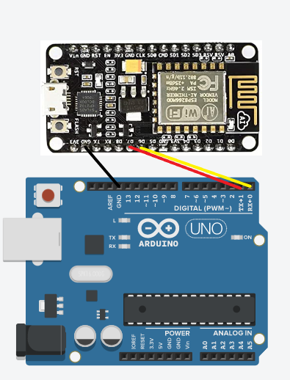
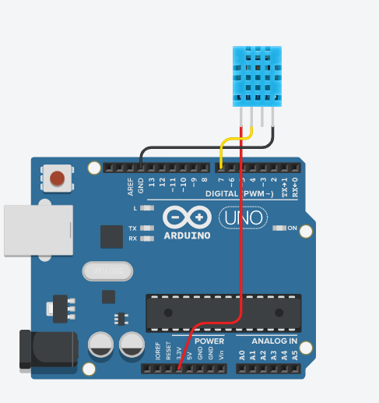
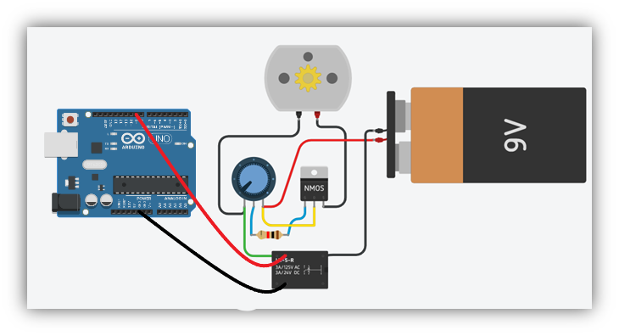
7
Circuitry, Coding and App
1) Sensor circuit 2) Control/Power circuit 3) UART circuit

Slide 9
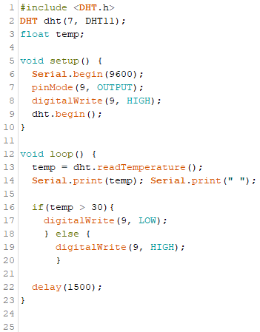
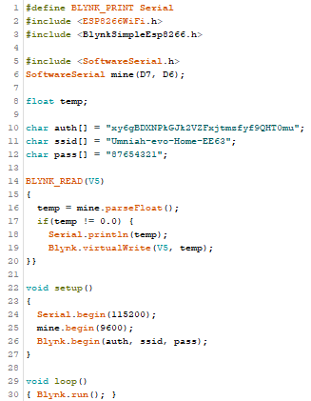
8
5) Arduino code 6) ESP code

Slide 10
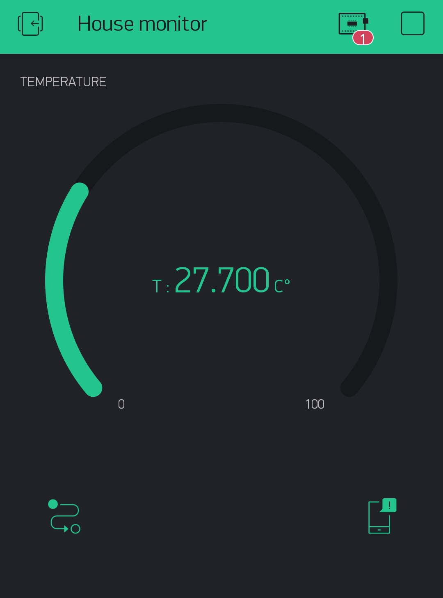
9
7) Blynk application

Slide 11
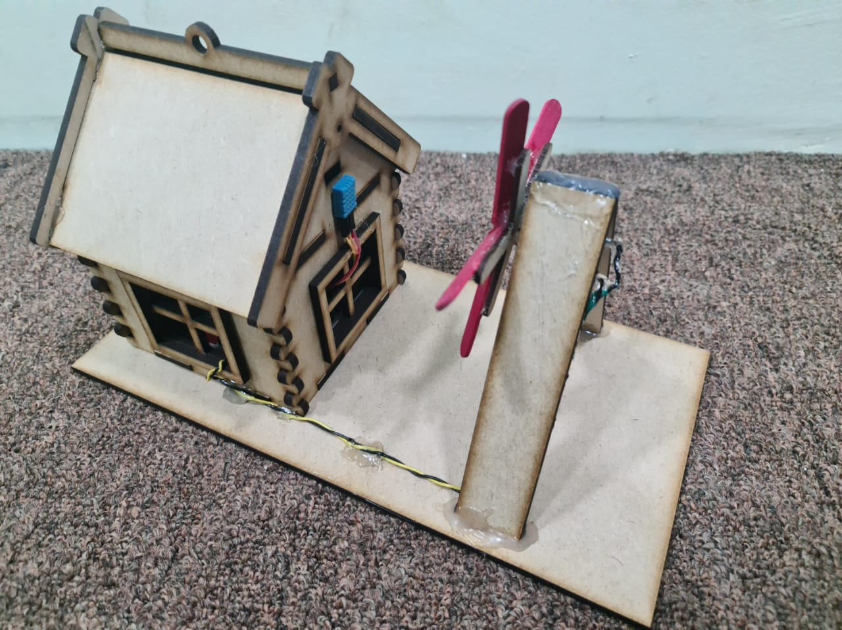
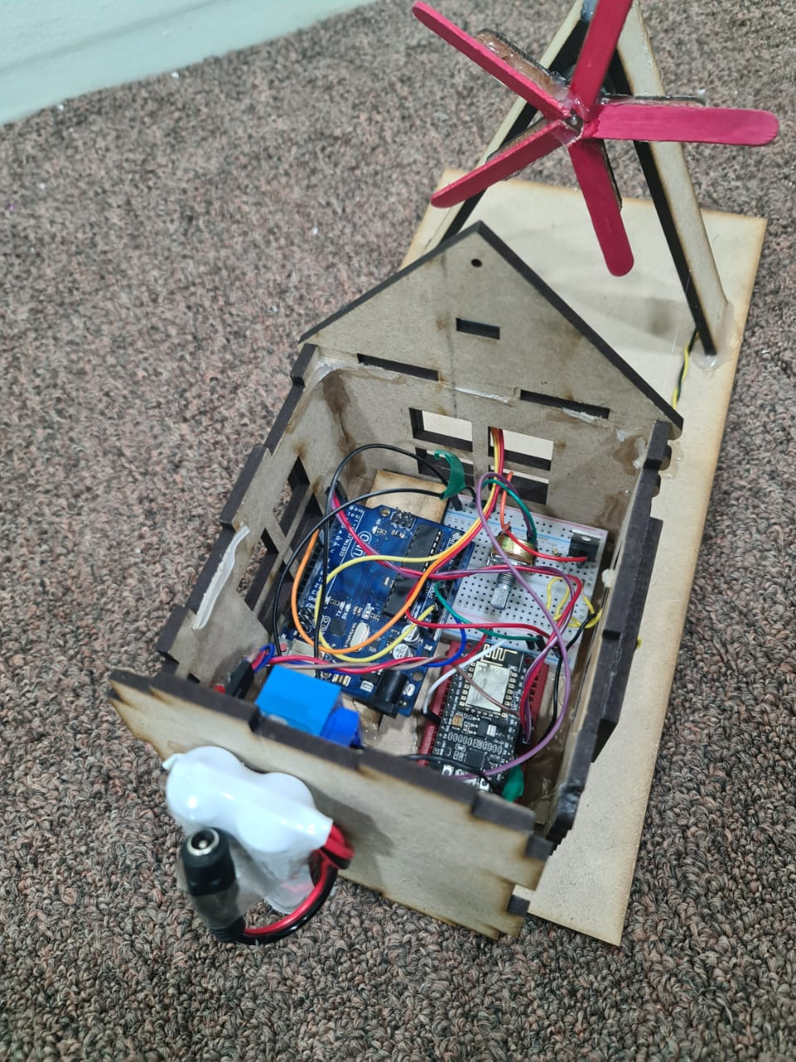
10
Presenting the Project

Slide 12
11
Challenges & Solutions
My DHT11 had burned when I supplied 5V instead of 3.3V
My 5V DC-motor had burned when I supplied 9V directly on it
I tried to use 5V regulator as a bridge but it limited the current beside the voltage
The DHT11 didn’t provide proper readings to the ESP alone so I had to find a way to get it
The UART serial connection couldn’t deliver data properly at data rate of 9600bps so I had to separate the serial between Arduino and ESP, from the one of sending data from the ESP and use data rate of 115200bps
The design was hard to modify to fit the project
I didn’t realize the relay module was active-low device so I had to use the Arduino to control it instead of the ESP

Slide 13
12
Conclusion

Slide 14
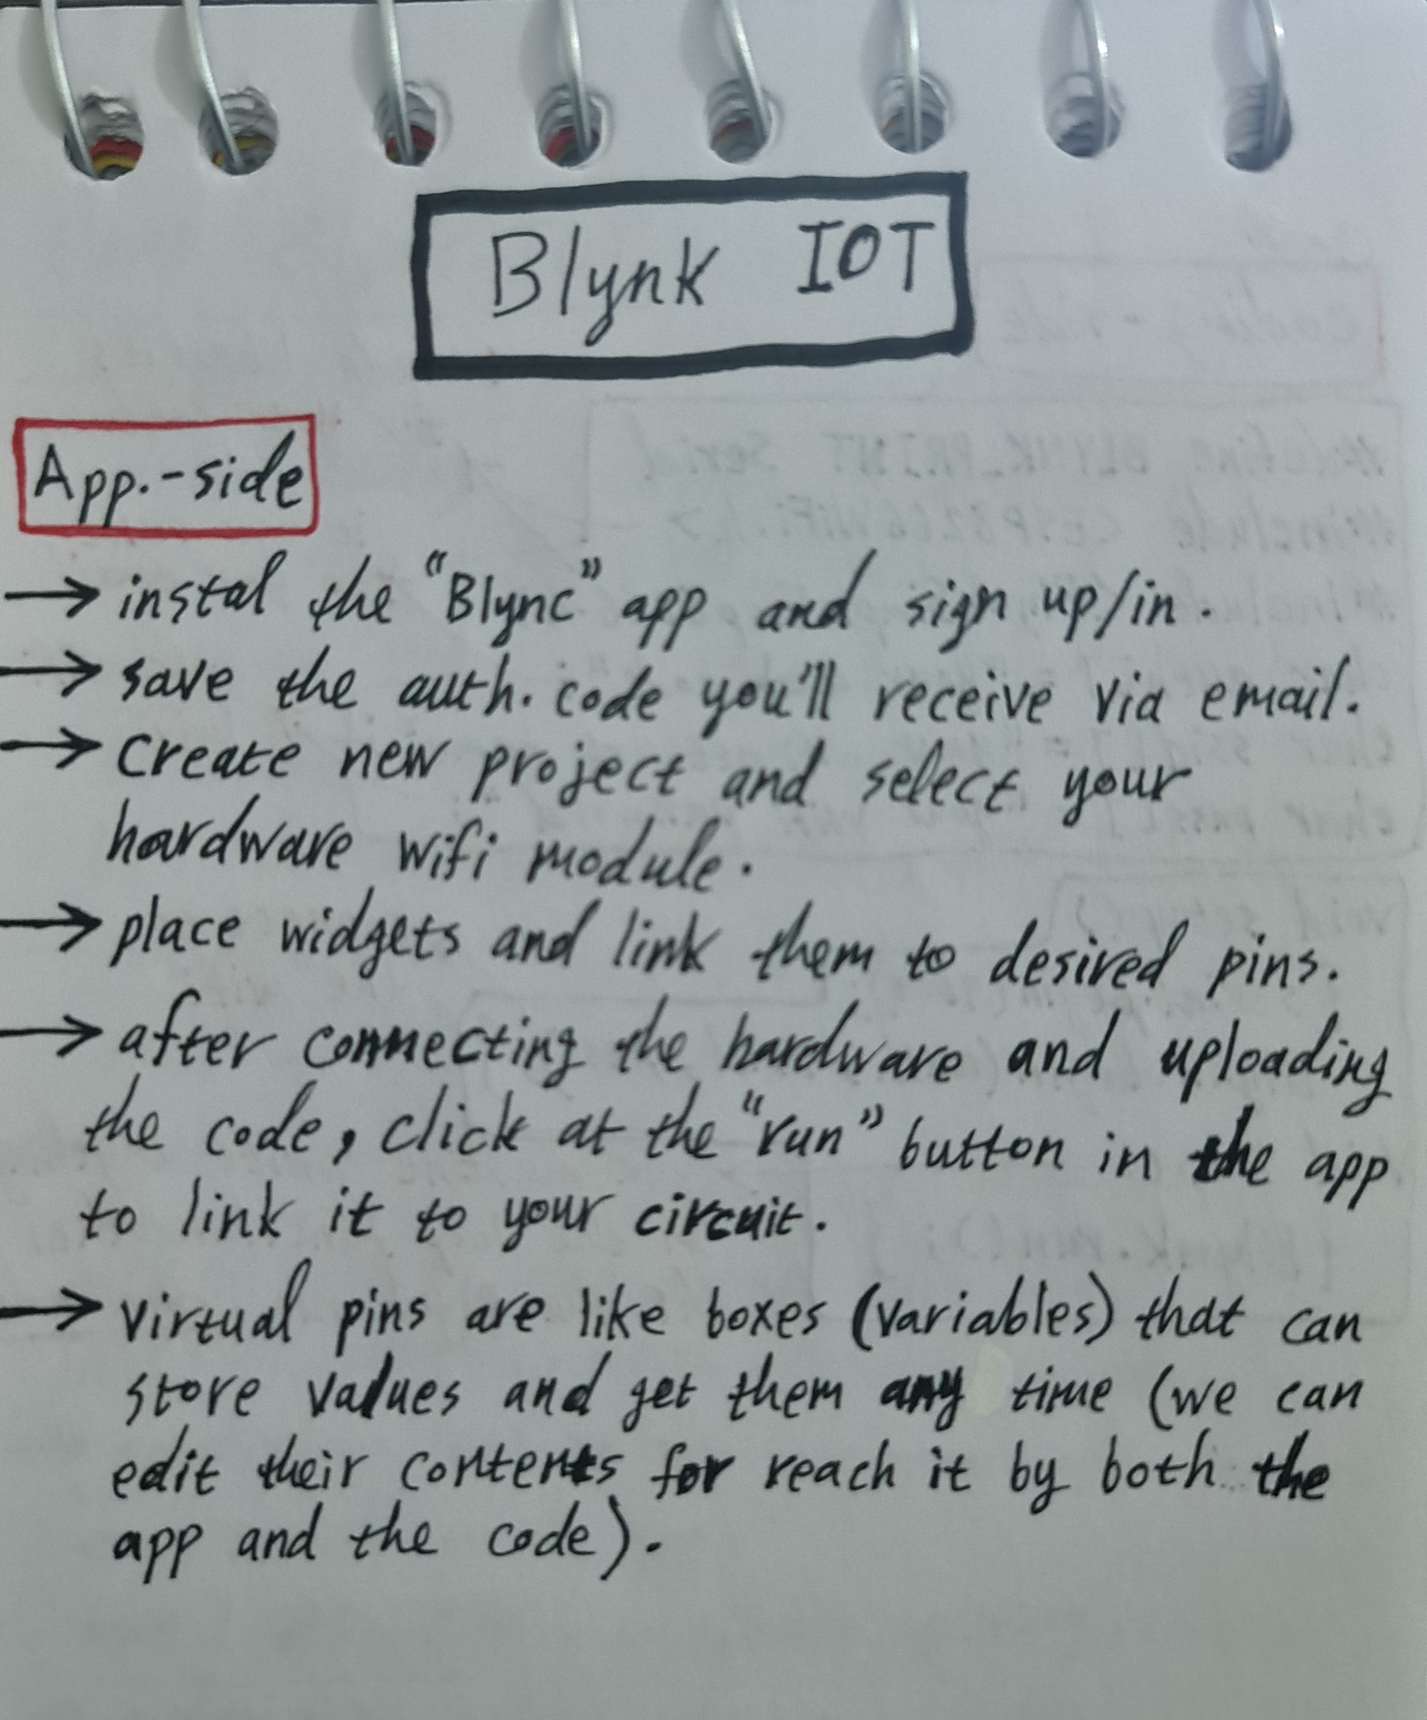
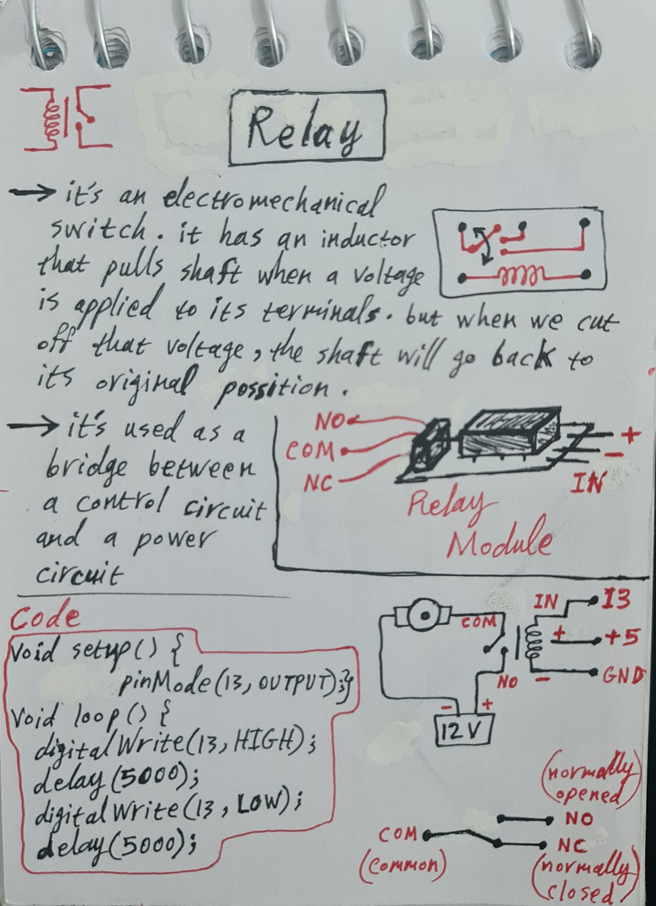
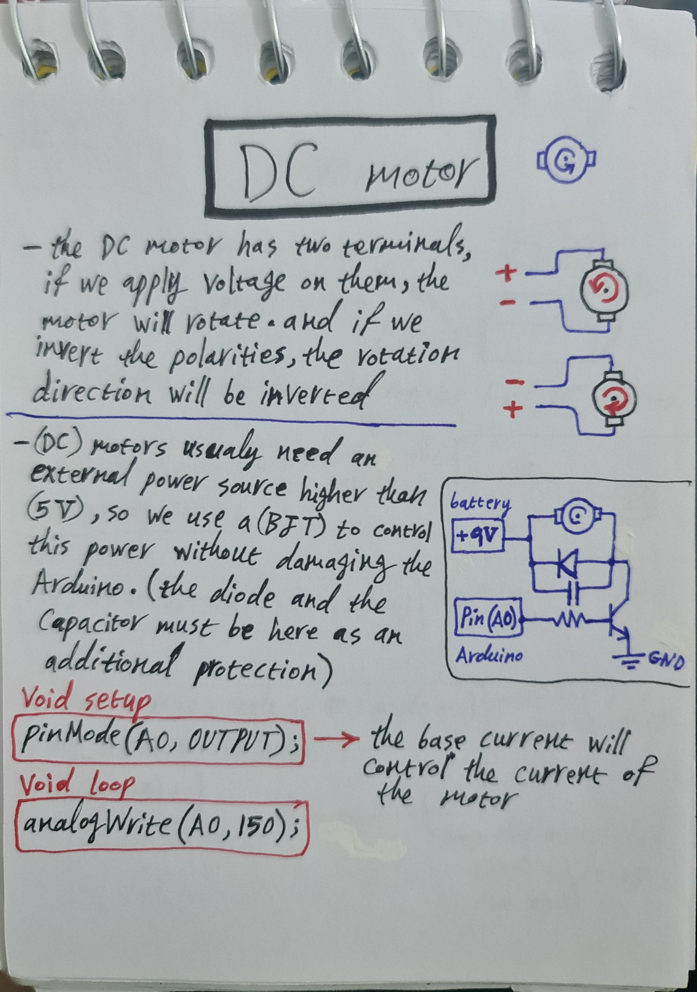
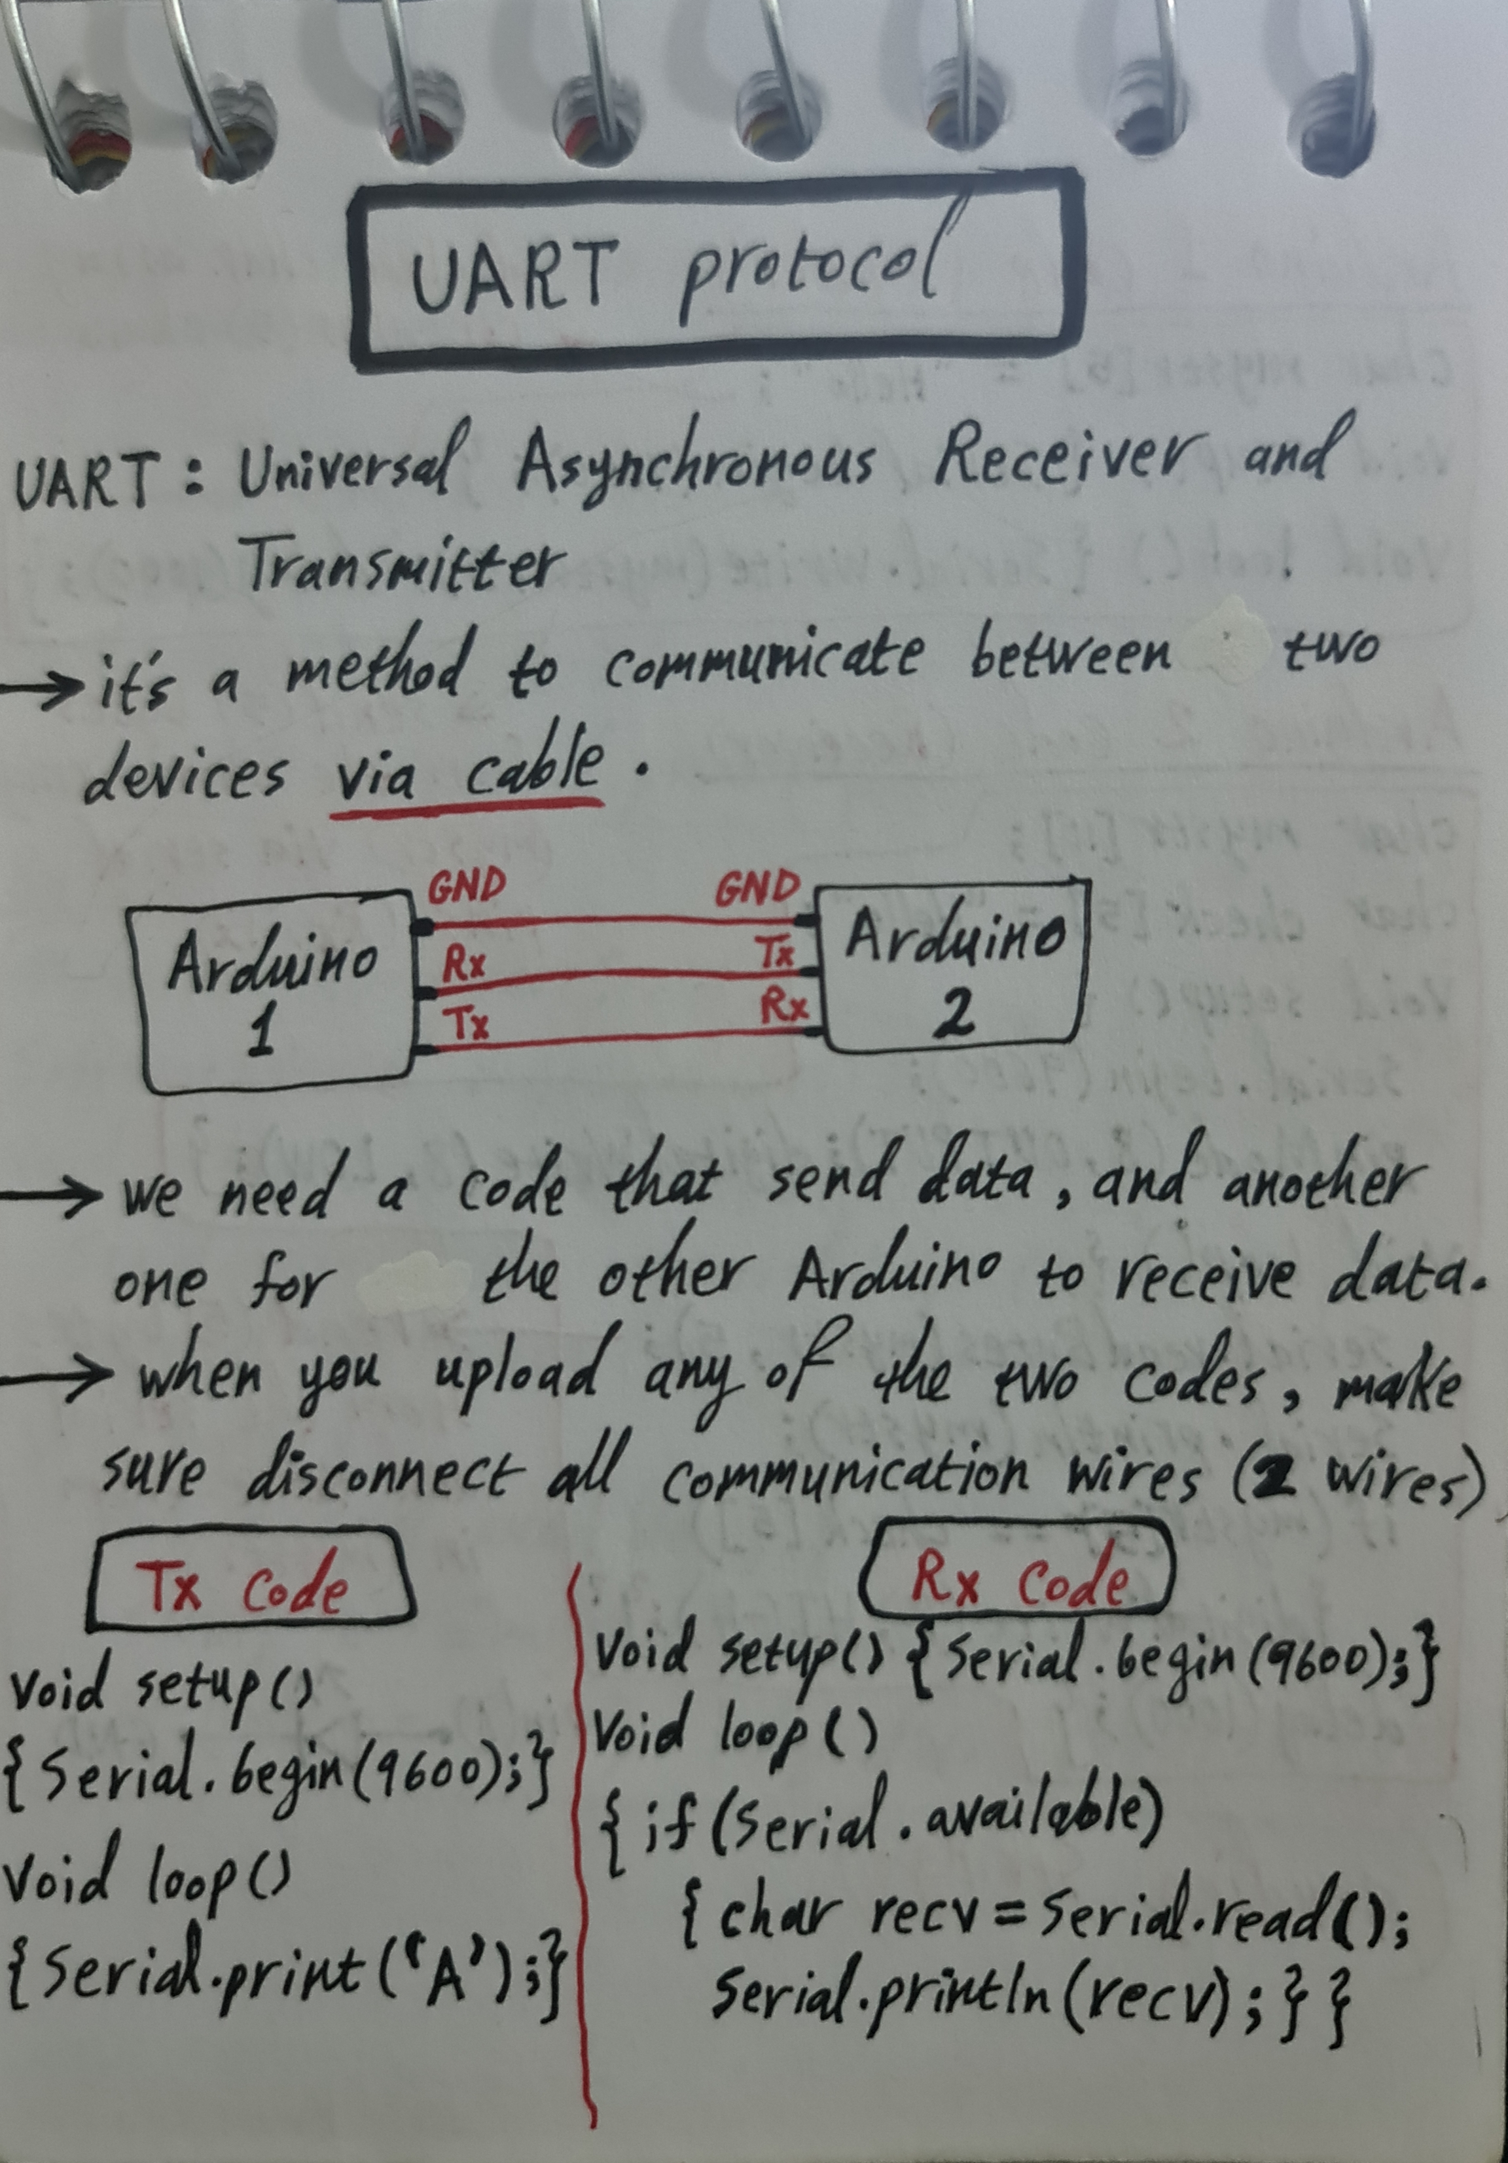
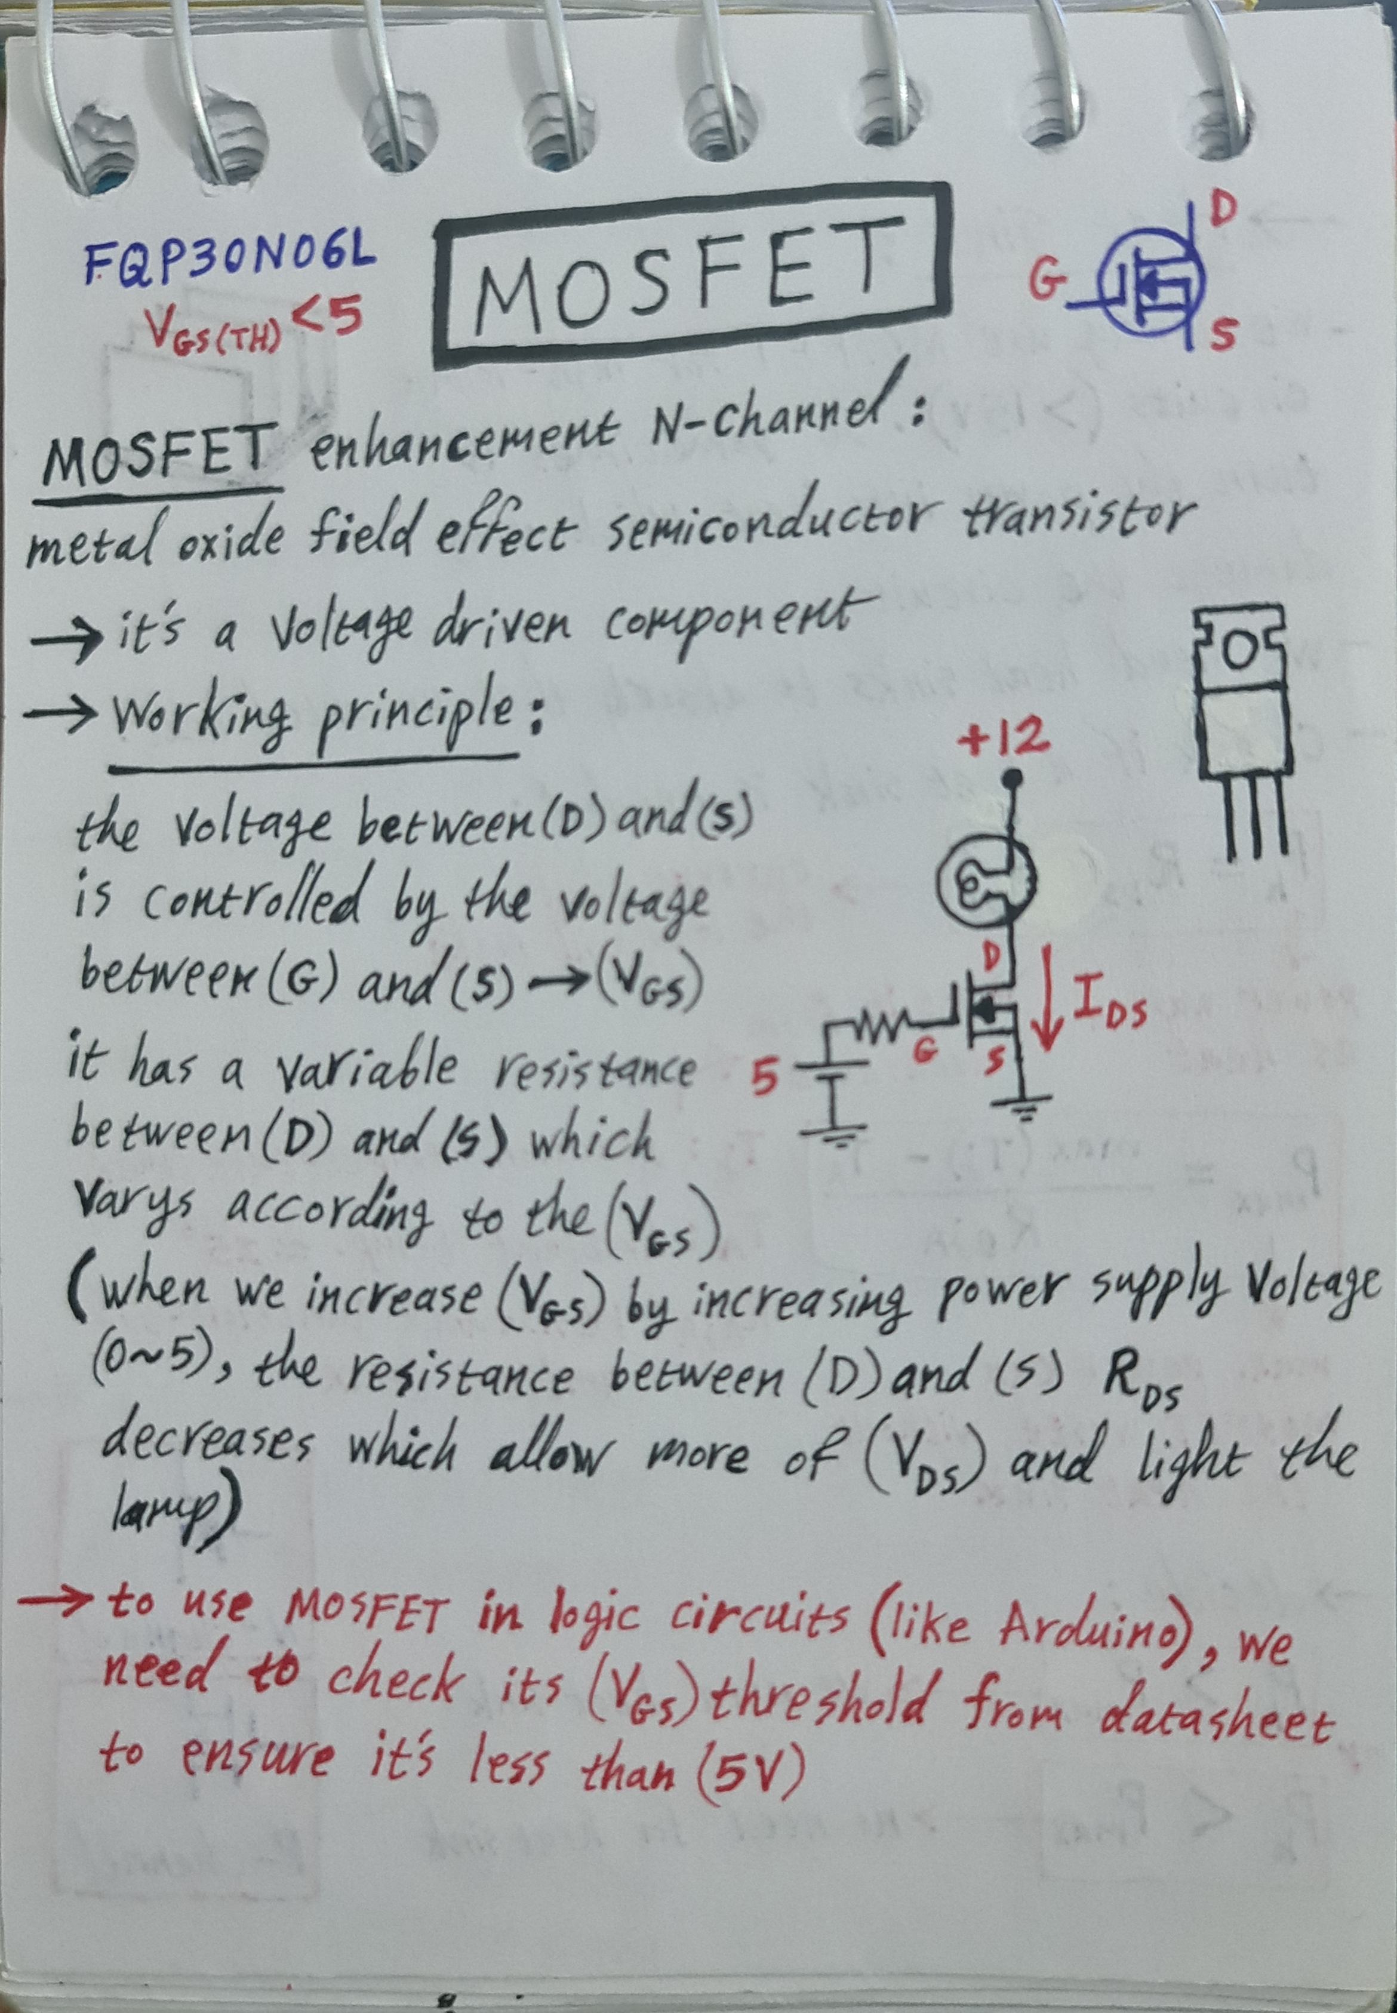
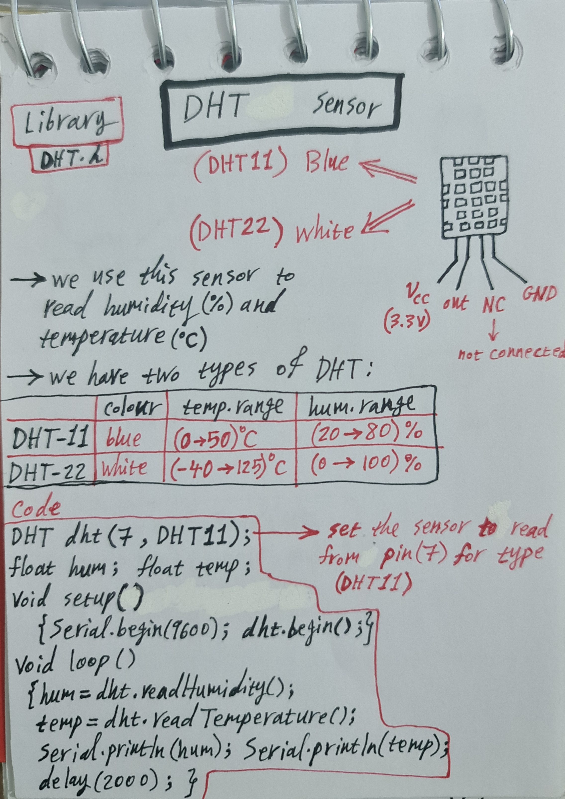
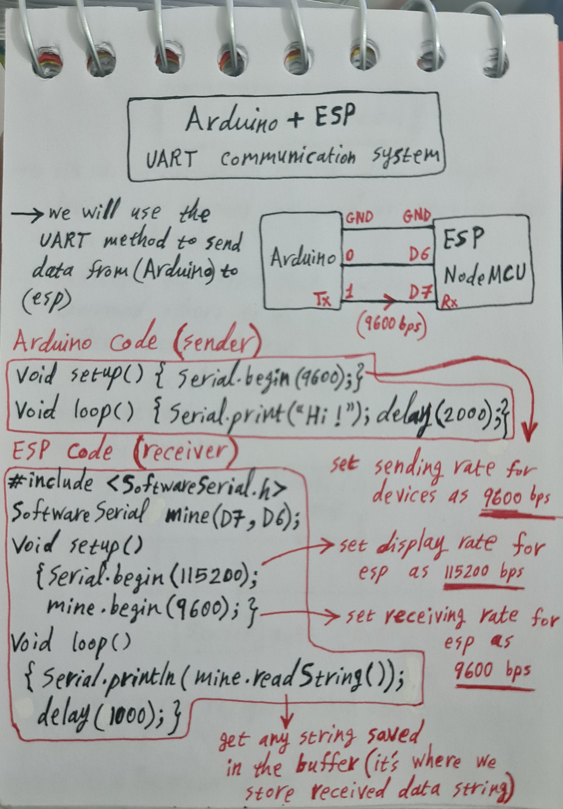
13
Preferences

Slide 15
14
Any Questions ???

Slide 16
The End

